Slide 1
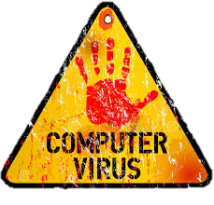

Slide 2
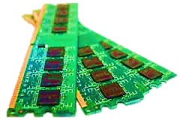
Memory Resident

Slide 3
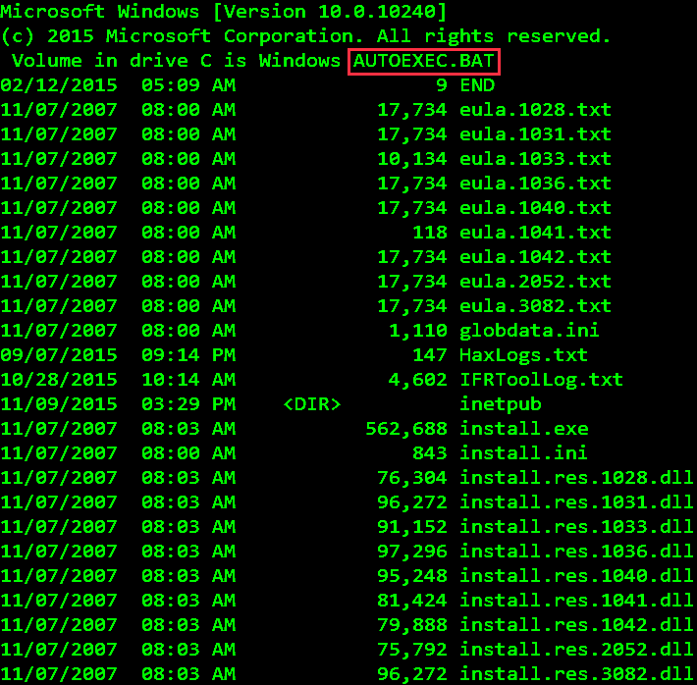
Directory Action

Slide 4
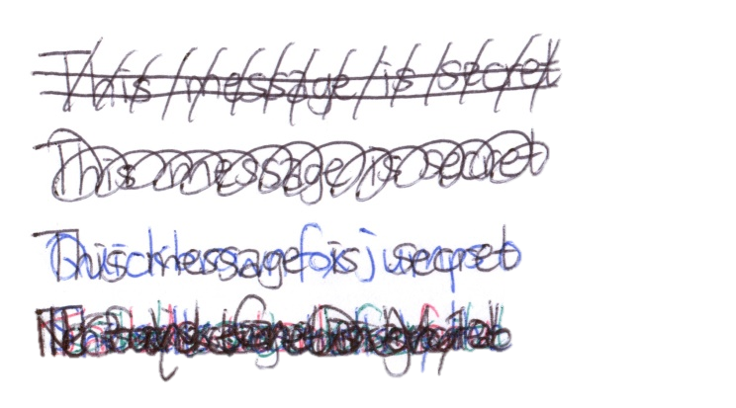
Overwrite

Slide 5
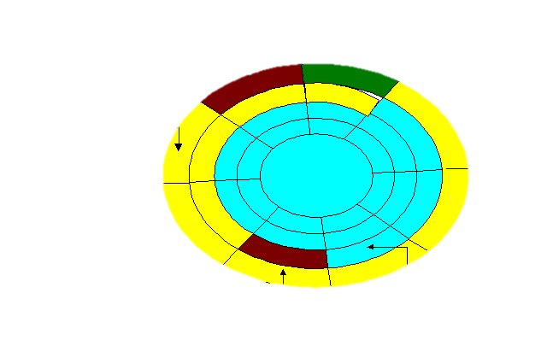
Boot Sector
Boot Sector (C:)

Slide 6


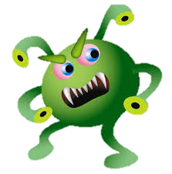
Macro

Slide 7

FAT Virus

Slide 8

Companion Viruses

Slide 9

Multipartite Virus

Slide 10

Polymorphic Virus

Slide 11
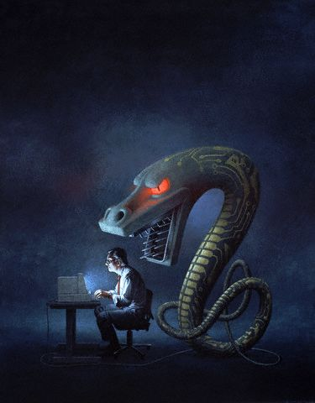
Worms

